Slide 1
Single Balance
Commissioning Plan
Version 1.3

Slide 2
Commission plan for Single Balance – Single Price Model
Purpose of this document is to describe on a high-level how the introduction of the Single balance model affects
  Imbalance Settlement model
  the market participants’ operations and
  eSett’s interfaces
This document describes what will change when the Single balance model will be taken into use:
  How imbalances are calculated, and the single balance position defined
  How the imbalance price is formed
  Describes the visible technical changes for the market participants in the operations between market participants and eSett
  Specifies the changes on Online Service user interface
  Summaries the changes in reporting of imbalance settlement results from eSett to BRP
This document is an initial commissioning plan, and it will be updated based on the updated information concerning Single balance model

Slide 3
Single Position – Single Price Model
High level concept

Slide 4
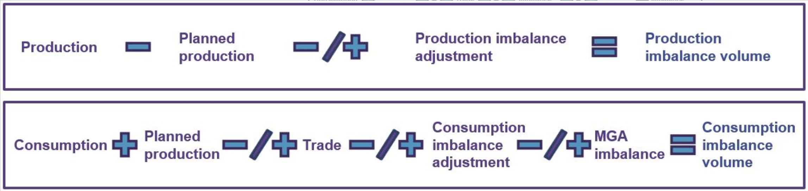

From two balances and single/dual pricing to single position and single price
The new single balance model is introduced in the European regulation and Electricity Balancing Guideline
The current imbalance settlement model will be changed from two balance model to single position – single price model
  Future imbalance settlement model (single price is used)
Financial settlement is achieved by using dual price in production and single price in consumption
Current
New
Financial settlement is achieved by using single price

Slide 5
The components of the new model will mainly remain the same in the formula
Metered and profiled consumption per metering grid area per retailer per hour.
Consumption is divided into the following types:
grid losses, interruptible consumption, industry consumption over 50MW, pumped storage and PU own consumption.
Trade includes:
PX market trade, the electricity trade concluded on the NEMO(s) – Day-ahead or Intraday.
Bilateral trade, the electricity trade that has been agreed upon between two market participants.
eSett calculates the MGA imbalance based on reported values from the Metered Data Aggregator. MGA Imbalance is calculated as follows:
MGA Imbalance = Consumption + Production + MGA exchange import per adjacent MGA + MGA exchange export per adjacent MGA
Production on hourly basis.
Production is divided into two categories, Normal and Minor. Following production types are defined:
hydro, wind, nuclear, thermal, solar and other.
Imbalance adjustment means the correction applied to the position of a BRP (or later a BSP) by TSO for the calculation of the imbalance volume.

Slide 6
Example: Calculation of Imbalance Volumes (input values)
Here below is presented an example of the BRP’s imbalance calculation (input values part). The example is made from the BRP’s perspective.
Imbalance | MWh
Metered production | 60
Profiled consumption | -5
Metered consumption | -15
Bilateral trades (purchase) | 5
Day-ahead trades (sale) | -25
Intraday trades (purchase) | 5
MGA Imbalance | -30
Imbalance adjustment (up regulation, sale to TSO) | -10

Slide 7
Example: Calculation of Imbalance Volumes (calculation)
Here below is presented an example of the BRP’s imbalance calculation (calculation part). The example is made from the BRP’s perspective.
Imbalance calculation [MWh]
Imbalance calculation | Metered Production | Metered + Profiled consumption | Bilateral + Day-ahead + Intraday trades | Imbalance Adjustments | MGA imbalance | Imbalance
Delivery period | 60 | -20 | -15 | -10 | -30 | -15
As a result of the BRP’s imbalance calculation there is a -15 MWh deficit in the BRP’s imbalance. The BRP buys 15 MWh from eSett.

Slide 8
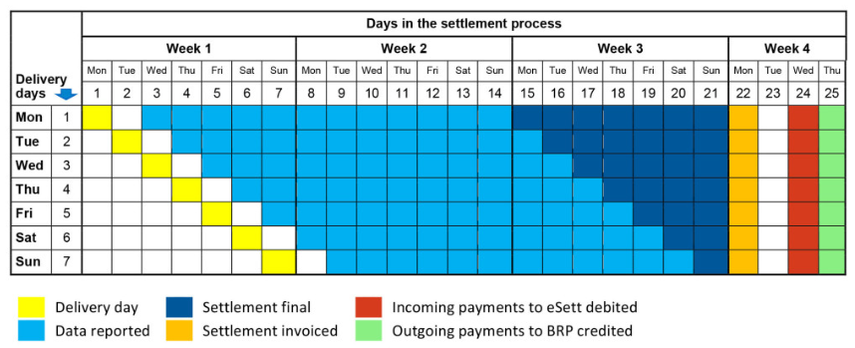
The main principles in the settlement will remain the same
No changes to the market roles
No changes to the reporting responsibilities
No changes to the settlement cycle
No changes to gate closures
No changes to invoicing process

Slide 9


Imbalance price
Imbalance is priced according to a single price model, which means that positive and negative imbalances have the same price per MBA.
The imbalance price has now been proposed by the Nordic TSOs to be the same as the mFRR price in the dominating direction.
This is the same imbalance price as for the current consumption imbalance. This is technically achieved using the incentivising component.
More information about imbalance prices can be found from Common Market Design description.

Slide 10

Minor production structure changes
In Finland and Norway, minor production is modelled in consumption balance in two balance model -> In single balance model minor production is modeled in a similar manner as normal production
  This change might lead to structure changes and RBR changes
  In Denmark and Sweden, all the production is using production type normal
Retailer of minor Production Unit valid after Go-Live date must have valid Retailer Balance Responsibility (RBR) for production in the MGA where the PU is located
In two balance model there needs to be a valid RBR for consumption in the MGA where the PU is located so in some cases there needs to be done adjustments
eSett has identified three different scenarios:
  Valid RBR for consumption and production (same BRP)
    As valid RBR exist no changes needed
  Only valid RBR for consumption
    BRP needs to create a new RBR for production
  Valid RBR for consumption and production (different BRPs)
    eSett will contact the market participants and the correct changes will be done in co-operation

Slide 11
Market Monitoring - Key Performance Indicators will be modified to fit to the new model
eSett has been publishing Key Performance Indicators (KPI) and advanced settlement reports for BRPs since the beginning of year 2019
  Advanced settlement reports offers statistics and graphs to review performance and identify potential issues
  BRP imbalance KPI report provides data for benchmarking and general information about the performance of BRPs
The main principles will be kept the same as today and only formulas will be adjusted to reflect changes caused by the single balance model
Old KPIs will be used for business days before the Go-Live day and new KPIs will be used for business days after Go-Live
As the production plan component is removed from imbalance calculations, a new KPI/formula will be established for monitoring long-term quality of production plans, Production Plan KPI:
  Calculate KPI for aggregated values per MBA per PU type (solar etc.)

Slide 12


Adjusted formulas on Single balance model
Imbalance Result:
Imbalance Factor
Imbalance Skewness

Slide 13

Adjusted formulas on Single balance model
Relative Imbalance
Production Imbalance Loss KPI is no longer relevant as single price is used instead of dual pricing

Slide 14
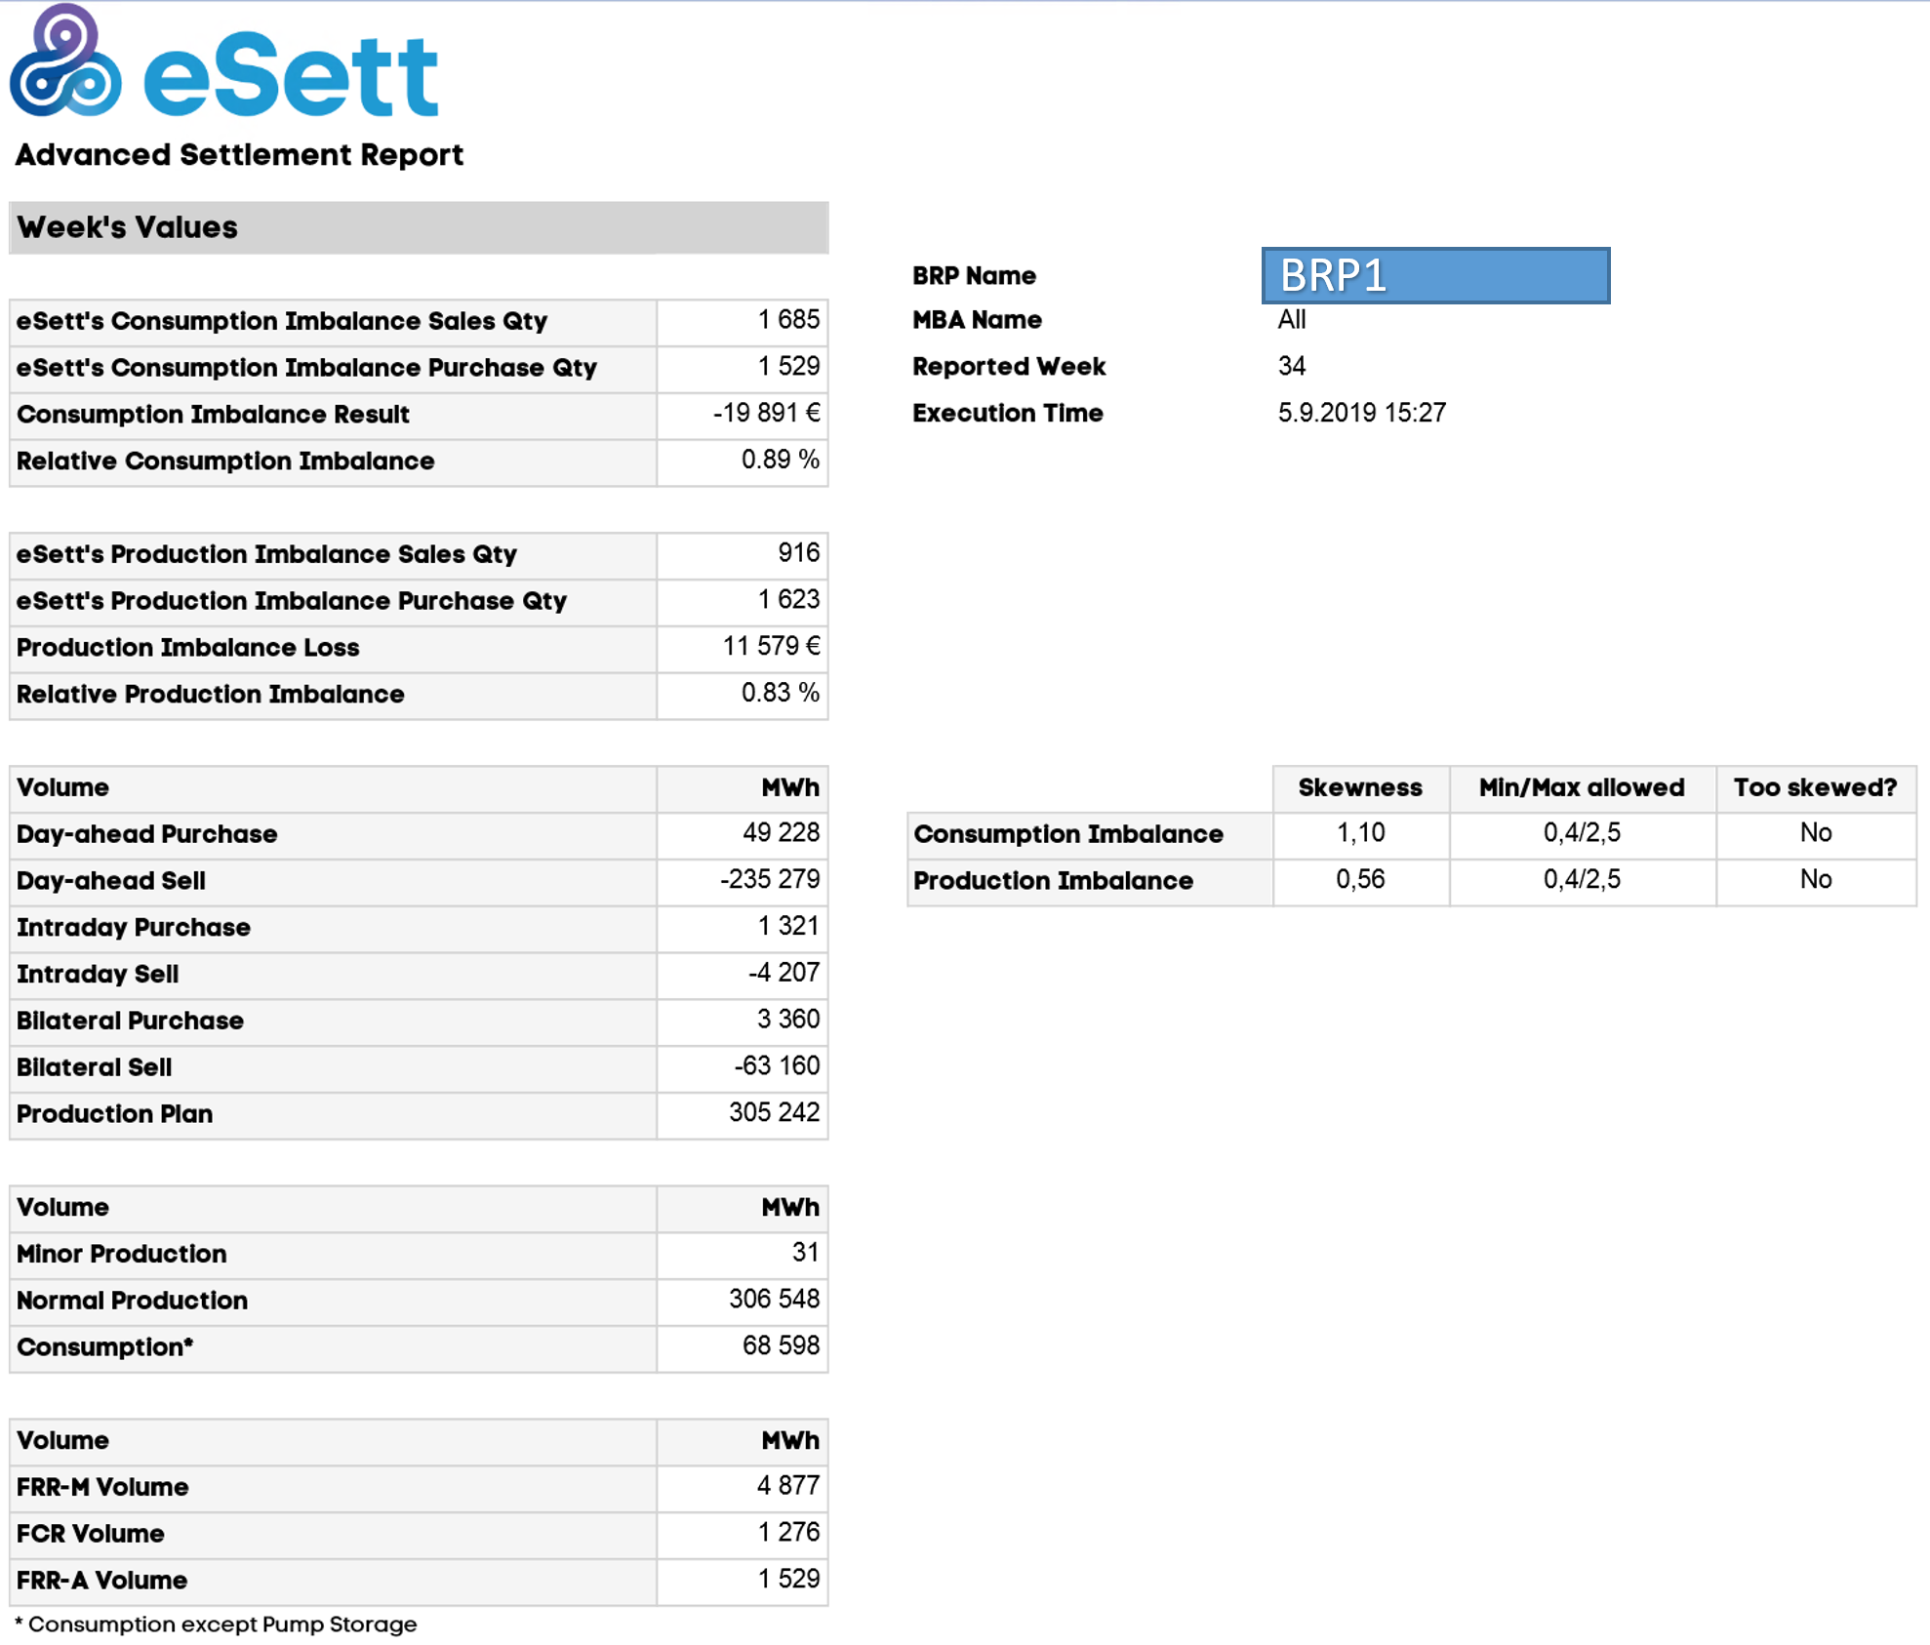
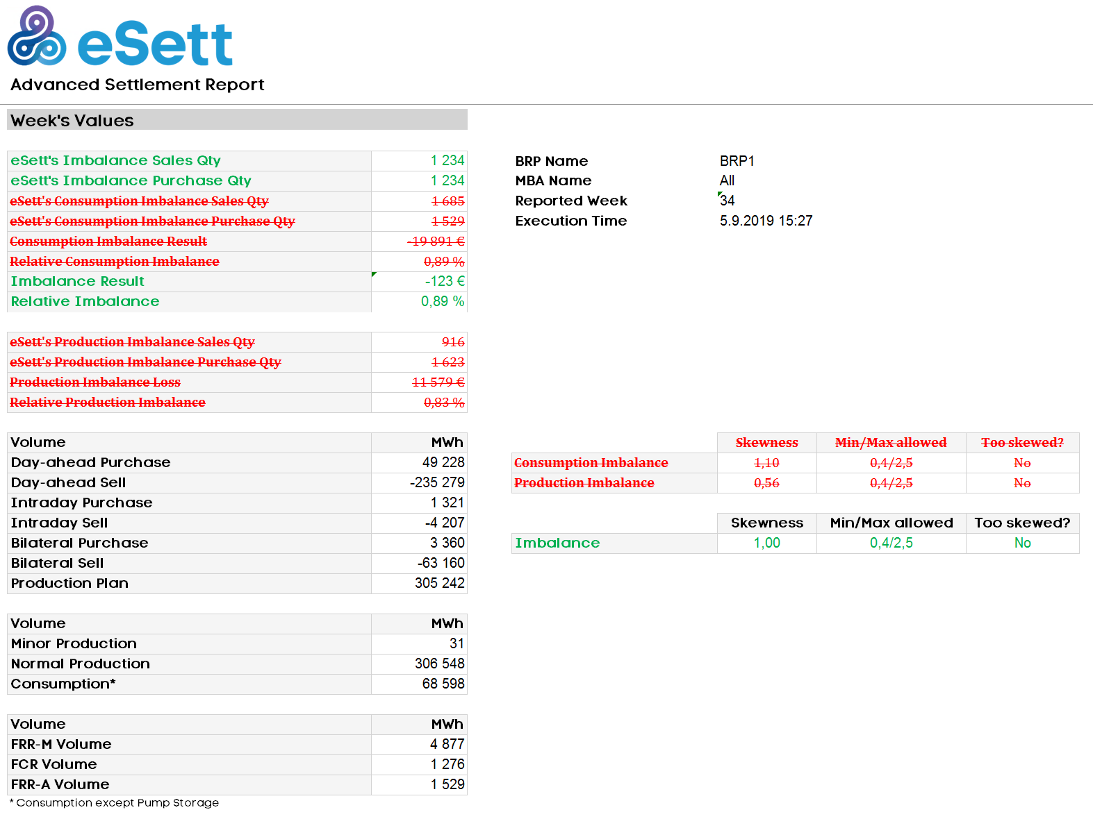
Advanced Settlement Report (Week/Month) changes
Current
New
Old charts will be removed, and new charts will replace them

Slide 15
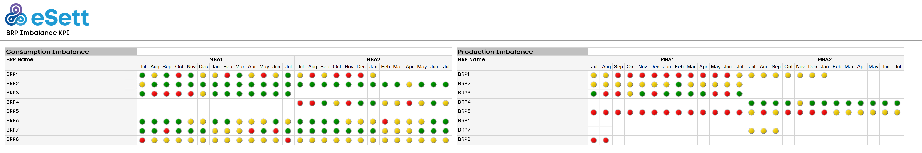
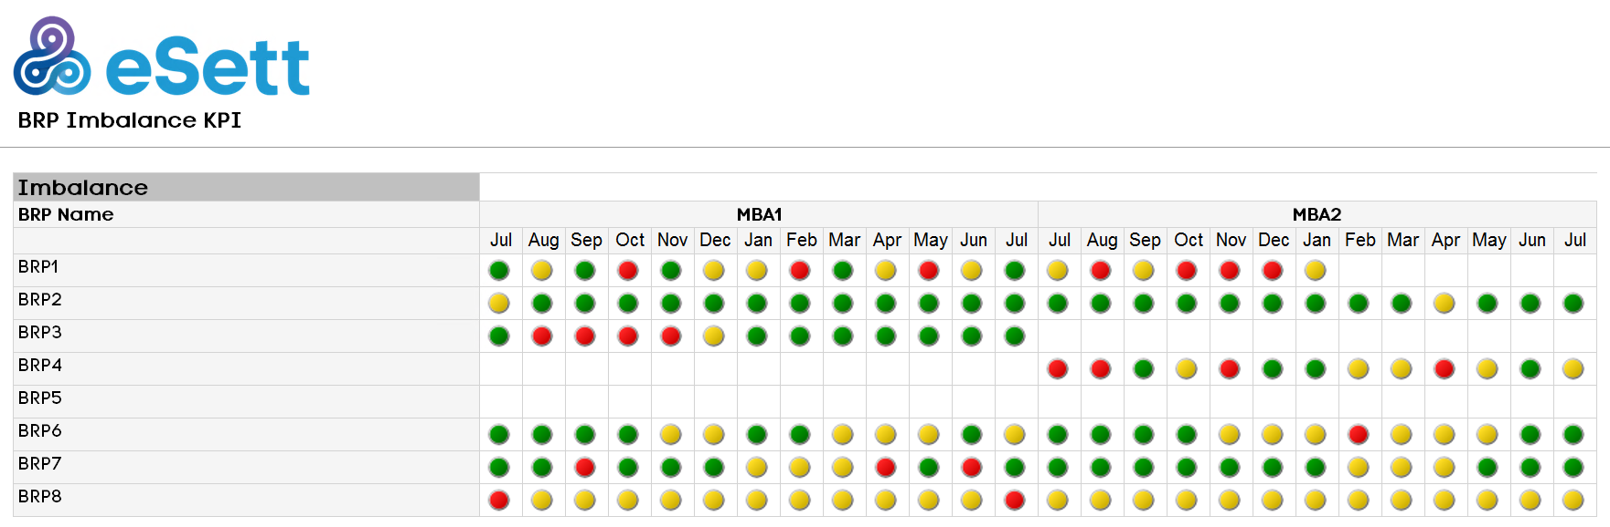
BRP Imbalance KPI Report (Own Data/Country) changes
Current
New

Slide 16
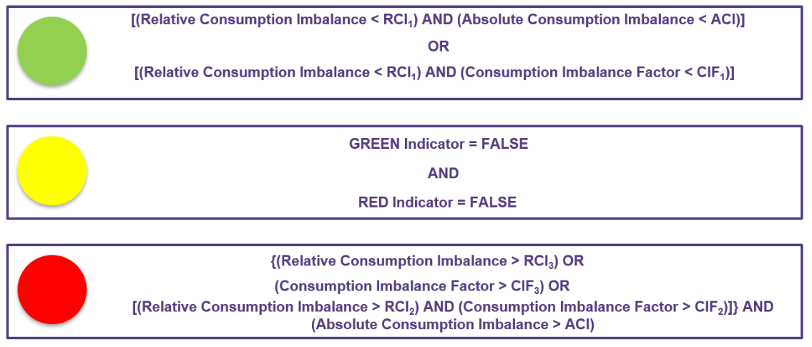
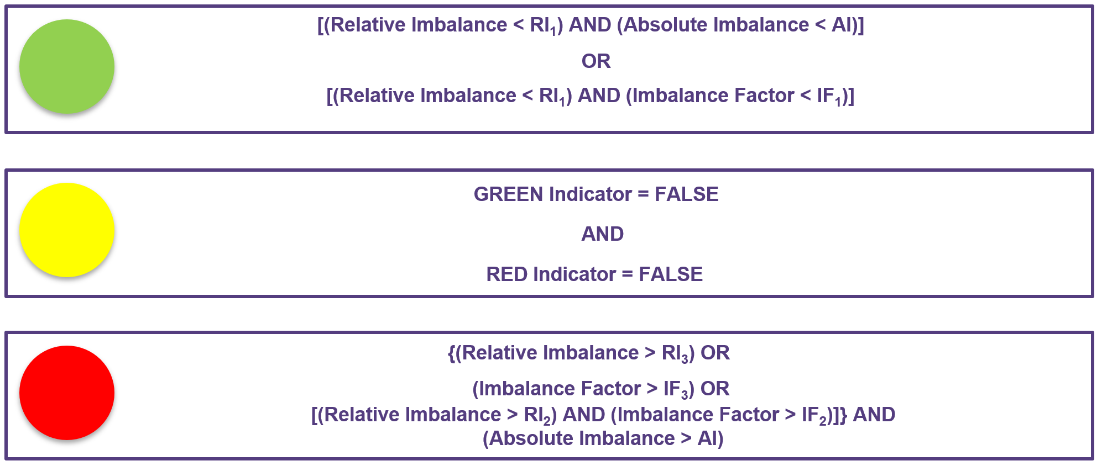
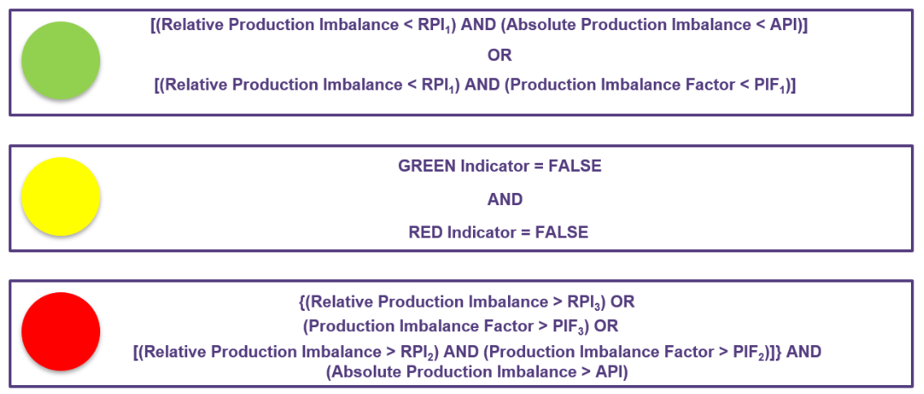
BRP Imbalance KPI Report new formula
Current
New
Current
New BRP Imbalance KPI Report’s threshold values per country will be the same as current threshold values on Consumption Imbalance side

Slide 17
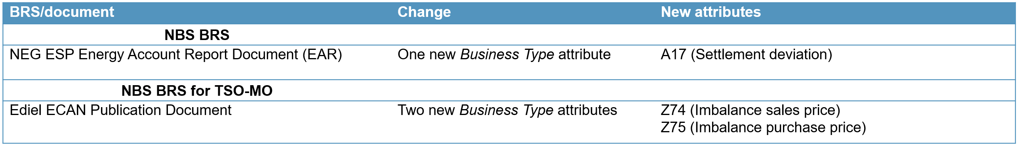
Transition phase reporting
eSett will start to use the new model after the Single balance model Go-Live date (GL) is introduced
Delivery days before GL will be calculated using the two balance model (e.g. where there is separate Consumption and Production imbalance)
Delivery days after GL will be calculated using the single balance and single price model
eSett will report settlement results based on which model the delivery day is using (before or after GL). During the transition period the settlement results consist of:
  Two balance model results
  Single balance results
Some attributes will be changed in the dataflows due to the Single balance model

Slide 18

Imbalance Settlement Agreement’s Appendices will be amended
The Imbalance Settlement and Pledge and Right of Disposal of Cash Account will not be amended
Appendices will be amended to reflect the changes of the model
  eSett will notice the market participants at least one (1) month beforehand
  New appendices will be published on www.eSett.com
  No resigning of the agreements required
Single price version of NBS Handbook has been published
Agreement / Appendix
Imbalance settlement agreement | No changes
Appendix 1 Fees | Minor updates, see next page
Appendix 2 Collaterals | Minor updates, see next page
Pledge and Right of Disposal of Cash Account Agreement | No changes
On-Demand Guarantee | No changes

Slide 19
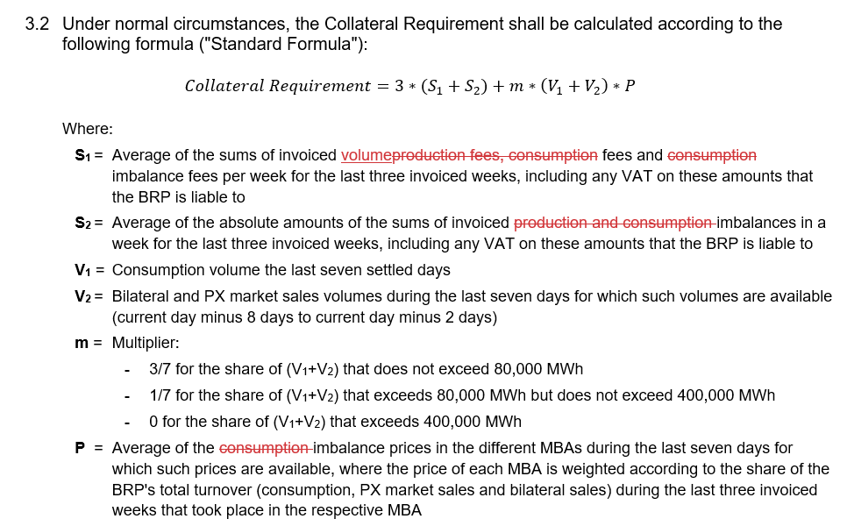
Amendments due to Single Balance Model in Agreement Appendices
Appendix 1 Fees
Appendix 2 Collaterals
The applicable fee rates per fee category and country are amended
Collateral formula will remain as today.
Fees and prices will be updated to reflect single balance model used
Two balance
Single balance
Consumption Fee
Production Fee
Consumption Imbalance Fee
Weekly Fee
Peak Load Reserve Fee
Volume Fee
Imbalance Fee
Weekly Fee
Peak Load Reserve Fee

Slide 20

Balance Agreement update needs
Balance agreements will be updated in Finland in September-October 2021
  eSett will co-ordinate the renewal
  Electronic signing will be used
In Denmark, Norway and Sweden, the change will not require changes to the Balance agreement.
20

Slide 21
Commissioning time schedule
Commissioning | 2020 |  |  | 2021
 | Oct | Nov | Dec | Jan | Feb | Mar | Apr | May | Jun | Jul | Aug | Sep | Oct | Nov | Dec
Customer Committee
Customer Committee
Go-Live
1.11.2021
Development of internal processes and IT-systems
Agreement updates
Minor production
structure changes will be done before Go-Live date
Single balance compactible NBS Handbook available
(English version)
As the changes in communication/data change are very limited,
eSett sees that there are no need for market testing period

Slide 22
Changes to the Market Participants

Slide 23

Changes to BRPs - Settlement
Minor Production Unit Structures
  Retailer of minor Production Unit valid after Go-Live date must have valid Retailer Balance Responsibility for production in the MGA where the PU is located.
  Possible changes to RBR relations will be adjusted co-operation with BRP and eSett
Prices
  Consumption Imbalance Purchase price, Consumption Imbalance Sales price, Production Imbalance Purchase price and Production Imbalance Sales price will be replaced by Imbalance Purchase price and Imbalance Sales price
  Price for Imbalance Purchase and Sales will be the same per imbalance settlement period (hour)

Slide 24
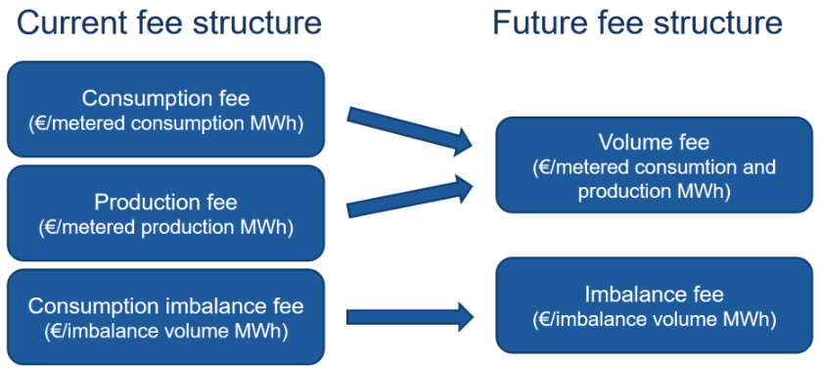
Changes to BRPs - Fees
Fees
  Consumption Imbalance Fee will be removed
  New Imbalance Fee will be introduced
  Consumption Fee and Production Fee will be removed
  New Volume Fee will be introduced
    Based on total consumption and production volumes
    Does not apply to Denmark as this fee will be collected through the grid tariffs instead
More information about Fees can be found from Common Market Design description
The picture above is taken from Single price and Single position –implementation
in the Nordics Common Market Design description document

Slide 25
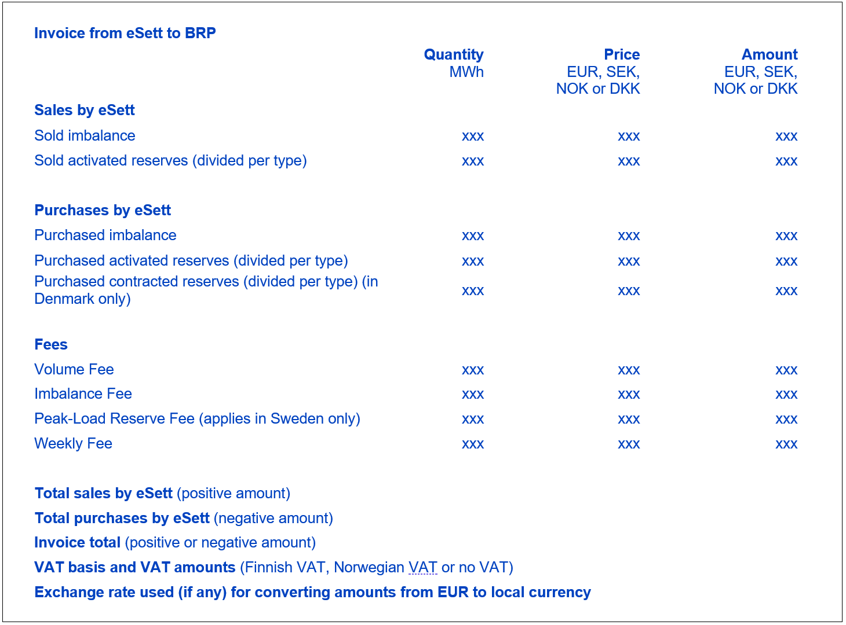
Changes to BRPs - Invoice content will change to reflect new model
Invoicing period and schedule remain the same
Just a few invoice products will be changed
Old invoice products will be used for business days before the Go-Live day and new Invoice products will be for used business days after Go-Live
Old Invoice product | New Invoice product
Sold consumption imbalance | Sold imbalance
Sold production imbalance
Purchased consumption imbalance | Purchased imbalance
Purchased production imbalance
Consumption Fee | Volume Fee
Production Fee
Consumption Imbalance Fee | Imbalance Fee

Slide 26
Changes to BRPs – Dynamic Collateral model will be adjusted to new model
Main principle will be kept the same in the dynamic collateral calculation
Two-balance model related components will be replaced by single balance model components
The dynamic collateral model will not apply during the transition period, and a manual collateral demand will be applied until there is sufficient data to calculate the dynamic collateral demand according to single balance model components
Before GL | Transition period | After transition period
Calculation of Collateral Demand for two-balance model regime will be used | Calculation of Collateral Demand will be paused. Instead manually set demand will be used (5 full weeks) | Calculation of Collateral Demand for singe balance model regime will be used

Slide 27
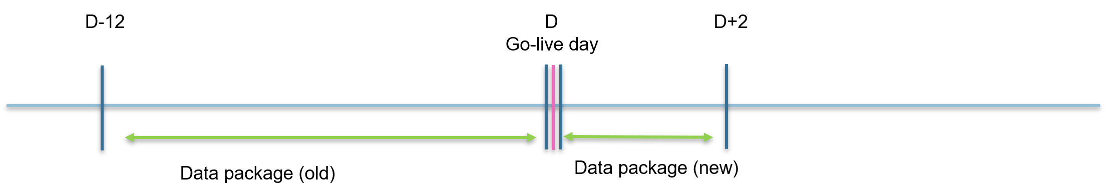
Changes to BRPs – number of data package will decrease
Single balance will reduce the amount of dataflows but the content of the dataflows will be the same
The changes are the same for Online Service Data packages and Information service in dataflows
Old Data package | New Data package
Consumption Imbalance – Preliminary Results | Imbalance – Preliminary Results
Production Imbalance - Preliminary Results
Consumption Imbalance – Final Results | Imbalance – Final Results
Production Imbalance – Final Results
Consumption Imbalance – Invoiced Results | Imbalance – Invoiced Results
Production Imbalance – Invoiced Results
Consumption imbalance per BRP per MBA (volume and amount) | Imbalance per BRP per MBA (Volume and Amount)
Production imbalance per BRP per MBA (volume and amount)
  Example on how data packages will be sent on day D+2 (where D is the Go-live day)

Slide 28
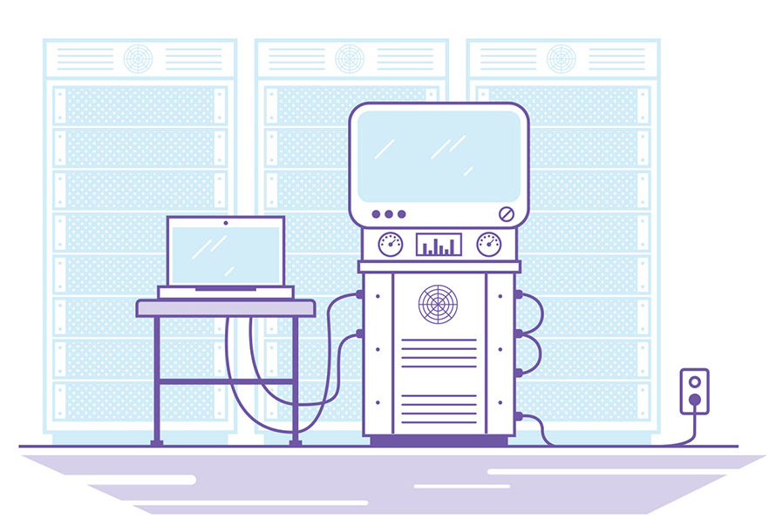
Changes to BRPs – Online Service views
Adjusted Market Reports and KPIs will be used (detailed description available in the updated NBS Handbook and in this document)
New “Imbalance” view will be added which uses same principles as Consumption/Production Imbalance view under Settlement part
New “Imbalance” radio button will be added which uses same principles as Consumption or Production radio button in Balance Report view
Invoicing Report will work as before, all related invoice products for selected time period will be presented
New Data Packages will be included in the list in Data Packages Management view
New Fees will be visible on the Fees view

Slide 29

For DSO and datahubs – single balance model introduces only minor changes
Structures for Minor Production Unit
  Retailer of minor Production Unit valid after Go-Live date must have valid Retailer Balance Responsibility for production in the MGA where the PU is located.
  These RBR relations need to be adjusted in co-operation with the BRP and eSett if needed.
Merged Production message (MEPI) can’t be sent for time period which covers both two balance and singe balance settlement days
  When sending MEPI, it is needed to split validity for the days before GL date and the days after GL date
  If MEPI’s validity covers days both side of GL date, it will get rejected

Slide 30

Changes for RE
Minor Production Unit structures
  Retailer of minor Production Unit valid after Go-Live date must have valid Retailer Balance Responsibility for production in the MGA where the PU is located.
  These RBR relations need to be adjusted co-operation with the BRP and eSett if needed.
Online Service views
  New “Imbalance” radio button will be added which uses same principles as Consumption or Production radio button in Balance Report view.

Slide 31

Key documents provide detailed information on changes
NBS Handbook (Single balance compatible version)
  Link
Online Service – User guideline
Single Balance related Data Package examples
  Link
NBS Business Requirement Specifications (BRS) –document
Single price and Single position – implementation in the Nordics: Common Market Design description
  Link

Slide 32
Change Log
Version | Date | Changes
1.0 | 27.5.2020 | First version of the Single Balance commisioning plan released
1.1 | 16.10.2020 | Information about Imbalance price updated Commisioning time schedule updated Information about new Fees updated MEPI-message information concerning DSO/Datahubs added
1.2 | 12.4.2021 | Example: Calculation of Imbalance Volumes
1.3 | 17.5.2021 | Information about agreement renewal updated Commissioning time schedule updated Key documents updated: Link to the Single Balance Handbook and data package examples

Slide 33
In case you need more information, please contact
eSett Customer Service
Create Customer Service Request on www.esett.com/contact
Send email to settlement@esett.com
Call +358 10 5018500

